Slide 1
Microsoft Teams – Authentication and Single Sign-on (SSO) with tabs & bots
Single sign-on (SSO) with Microsoft Teams tabs

Slide 2

Overview
Understand the SSO authentication flow
Configure the Azure AD application for SSO with Microsoft Teams tabs
Implement SSO in Microsoft Teams tabs

Slide 3
Understanding SSO in Microsoft Teams tabs

Slide 4
Microsoft Teams can't prompt for to consent Microsoft Graph permissions
Microsoft Teams apps can use SSO to call Microsoft Graph
Tabs first trigger the Microsoft Teams client to obtain the bootstrap/ID token with getAuthToken()
Bootstrap token exchanged with Azure AD for an access token used to call Microsoft Graph

Slide 5
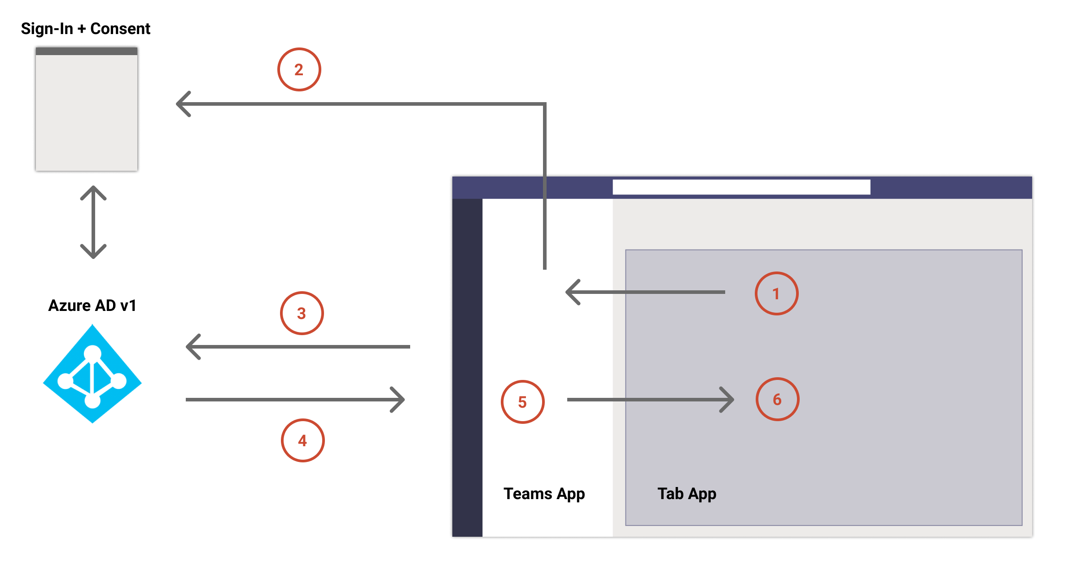
Understanding SSO in Microsoft Teams tabs
Notes:
1. In the tab, a JavaScript call is made to `getAuthToken()`. This tells Microsoft Teams to obtain an authentication token for the tab application.
2. If this is the first time the current user has used your tab application, there's a request prompt to consent if consent is required or to handle step-up authentication such as two-factor authentication.
3. Microsoft Teams requests the tab application token from the Azure AD endpoint for the current user.
4. Azure AD sends the tab application token to the Microsoft Teams application.
5. Microsoft Teams sends the tab application token to the tab as part of the result object returned by the `getAuthToken()` call.
6. The token is parsed in the tab application using JavaScript, to extract required information, such as the user's email address.

Slide 6
Microsoft Teams & Microsoft Graph
Microsoft Teams clients are limited in prompting for user consent to the OpenID profile permission
Microsoft Teams clients can’t prompt user for consent to Microsoft Graph permissions
If user hasn’t consented to Microsoft Graph permission, when the bootstrap token is exchanged for an access token, Azure AD returns the error: AADSTS65001 When your app receives this error code, it should gracefully handle the scenario with a fallback authorization system
Launch popup dialog to prompt the user to consent to Microsoft Graph permissions

Slide 7
Obtain ID token from Microsoft Teams
microsoftTeams.authentication.getAuthToken({
successCallback: (result: string) => {
this.ssoLoginSuccess(result)
},
failureCallback: (error: string) => {
this.ssoLoginFailure(error)
}
});
Use the Microsoft Teams JavaScript SDK to obtain token
Microsoft Teams will request an an ID token from Azure AD
The token returned contains claims to identify the currently signed in user
The token can’t be used to authorize Microsoft Graph requests

Slide 8
Exchange the ID token for an access token for Microsoft Teams
Use the ID token obtained by Microsoft Teams to obtain an access token that can be authorized to call Microsoft Graph
Use the OAuth2 on-behalf-of flow to obtain a token to call Microsoft Graph
This exchange must happen in a server-side API, not client-side
HTTP POST https://login.microsoftonline.com/{tenant-id}/oauth2/v2.0/token
CONTENT-TYPE: application/x-www-form-urlencoded
client_id={client_id},client_secret={client_secret},
grant_type=urn:ietf:params:oauth:grant-type:jwt-bearer,
requested_token_use=on_behalf_of,
assertion={sso_id_token},
scope=profile openid User.Read Mail.Read

Slide 9
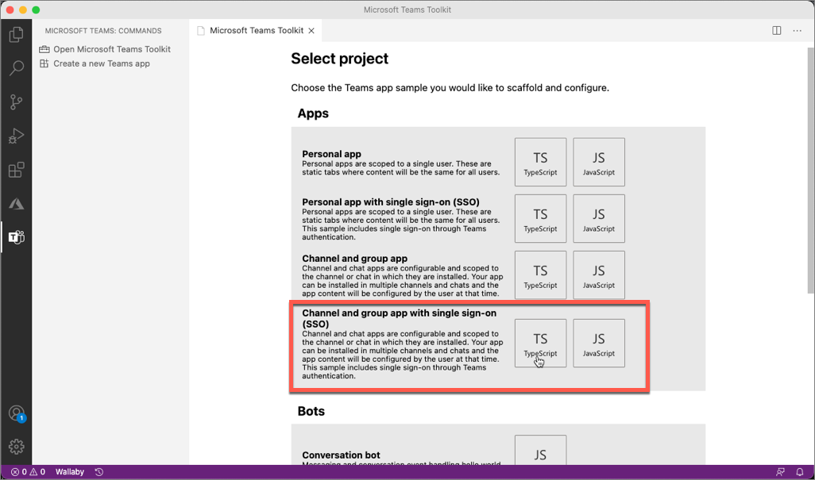
Microsoft’s Teams Toolkit & SSO for tabs
Microsoft Teams Toolkit contains project templates for creating tab projects that support SSO
Registers the Azure AD app required
Contains server-side API project to handle exchange of ID token for an access token to call Microsoft Graph
Contains tab project configured to obtain ID token from Teams

Slide 10
Demo

Slide 11

Summary
Understand the SSO authentication flow
Configure the Azure AD application for SSO with Microsoft Teams tabs
Implement SSO in Microsoft Teams tabs

Slide 12
Thank you.

